Slide 1
LLM-based Chatbot for PGRKAM Employment Portal
CSE7101- Capstone Project
Review-1
Batch Number: CSE_261
Under the Supervision of,
Ms. Saiqa Khan N
Assistant Professor
School of Computer Science and Engineering
Presidency University
Roll Number | Student Name
20221CSE0332 20221CSE0425 20221CSE0483
Prajwal P
N Vishal
Prayas Mohanty
Name of the Program: B-tech(CSE)
Name of the HoD: Dr Asif Mohammed
Name of the Program Project Coordinator: Dr. Jayavadivel Ravi
Name of the School Project Coordinators: Dr. Sampath A K , Dr. Geetha A

Slide 2
Content
Problem Statement
Objectives
Background and Related work for title Selection
Analysis of Problem Statement
Innovation or Novel Contributions
Git-hub Link
Timeline of the Project
References

Slide 3
Problem Statement Number: PSCS 17
Organization: Presidency University
Category (Hardware / Software / Both) : Software
Problem Description : The PGRKAM (Punjab Ghar Ghar Rozgar and Karobar Mission) portal offers diverse services—job listings, self-employment avenues, foreign jobs, counseling, and more—but lacks an interactive guide. Users must navigate multiple modules manually, leading to confusion and delays.
This project develops an LLM-powered chatbot to provide real-time, multilingual, and context-aware assistance, helping users quickly access relevant services. By integrating with the portal and using RAG(Retrieval-Augmented Generation) and domain-specific tuning, it aims to streamline navigation and improve user experience.

Slide 4
Objectives
Develop an intelligent chatbot to assist users in navigating the PGRKAM portal and mobile app.
Provide real-time, context-aware guidance for diverse services (jobs, counseling, self-employment, etc.).
Enable multi-lingual interaction to cater to diverse user groups.
Improve overall user experience, efficiency, and service accessibility.

Slide 5
Background and Related work for title Selection
Chatbots have been widely implemented in customer service, education, and healthcare to improve user engagement.
Recent advances in Large Language Models (LLMs) enable more context-aware and conversational assistants.
Existing government service portals often lack interactive guidance systems.
References:
1. An LLM-Driven Chatbot in Higher Education for Databases and Information Systems (IEEE, 2024).
2. A Complete Survey on LLM-based AI Chatbots (IEEE, 2024).

Slide 6
Analysis of Problem Statement
Key Challenges:
- Identifying user intent accurately from free-form queries.
- Mapping queries to relevant portal modules and services.
- Integrating chatbot seamlessly with existing infrastructure.
- Handling diverse queries across multiple service categories.
- Maintaining performance and accuracy at scale.

Slide 7
Analysis of Problem Statement (contd...)
Software and Requirements:
Programming Language: Python 3.10
Backend Framework: FastAPI
Frontend: React.js
LLM Integration: OpenAI API
RAG Implementation: LangChain
Database: PostgreSQL(powerful open-source relational database)
Vector Database: Pinecone(database built to store and search through vectors)
Version Control: Git & GitHub
Deployment: Docker, AWS EC2
Environment Management: Conda(package manager)
IDE: Visual Studio Code

Slide 8
Innovation or Novel Contributions
Domain-specific fine-tuning of LLM for PGRKAM services.
Retrieval-Augmented Generation (RAG) for accurate, context-based responses.
Integration with portal database and service APIs.
Future scope: multi-lingual and voice-based interactions.

Slide 9
Git -hub Link
GitHub Repository : https://github.com/prjawal21/llm_based_chatbot.git

Slide 10
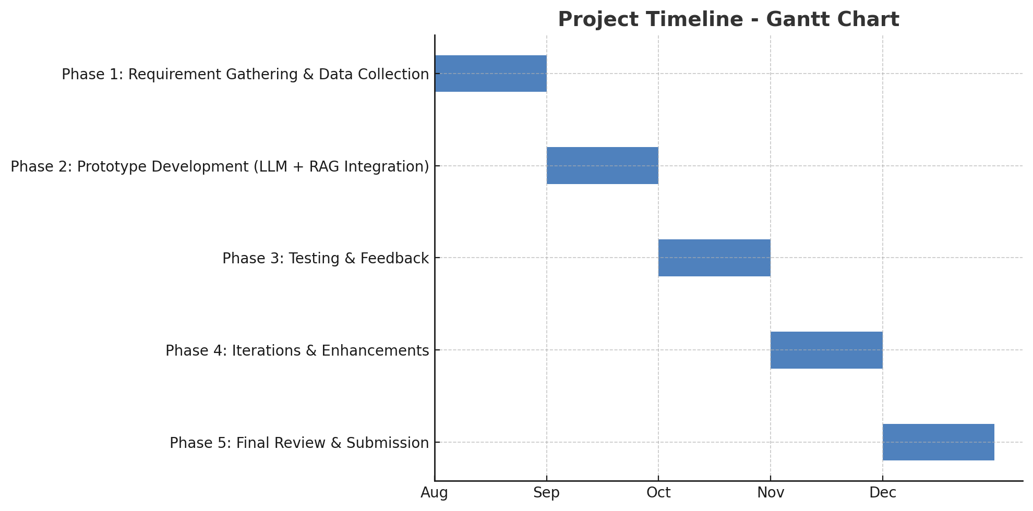
Timeline of the Project

Slide 11
References
[1] J. Smith, 'An LLM-Driven Chatbot in Higher Education for Databases and Information Systems', IEEE, 2024.
[2] M. Johnson, 'A Complete Survey on LLM-based AI Chatbots', IEEE Access, 2024.
[3] S. Kumar, 'Chatbot Applications in Government Services', IEEE Transactions, 2023.

Slide 12


